Slide 1
Outline (Slides 1-19):
- Graphical Solution Notes/Definitions
- Possible Outcomes of an LP
- Graphical Solution Examples
For Review (Slides 20-36) - Standard Form and Matrix Notation
- Basic Solution Notes/Definition
Notes:
1

Slide 2
Definitions/Notes:
Each constraint of a problem represents a “halfspace” (including each non-negativity constraint). For example: x₁+x₂ = 4 splits the region into two spaces, the regions x₁+x₂>4 and x₁+x₂<4. The feasible region of an LP is the intersection of the halfspaces. This region will always be a convex set (since we are dealing with linear constraints). Convex Set: if two points are in the set, the line segment adjoining those two points is also in the set.
Convex:
Not Convex:

Slide 3
Definitions/Notes:
Extreme Point: points that don’t lie on the interior of the line segment joining two other distinct points of the convex set. If an LP has an Optimal Solution, at least one of the Optimal Solutions will be at an extreme point.
Represents Extreme Point
If two extreme points lie on the same boundary edge, they are called adjacent extreme points.

Slide 4
Definitions/Notes:
Level Curves (Contours): level curves of an objective function are given by a constant value of objective Z The gradient points in the direction of increase in the objective function. Gradient represented by: Therefore, level curves are perpendicular to gradient.
gradient
level curves

Slide 5
Initial Problem:
x₂
(1)
(1)
(2)
(2)
Optimal Solution occurs at intersection of (1) and (2). (i.e., (1) and (2) are binding constraints)
3x₁ + 2x₂ = 6 2x₁-x₂=2 (2 equations, 2 unknowns) x₁=10/7, x₂=6/7 Z = 26/7
Optimal Solution, x*
x₁
Notes:
Binding constraint; non-binding constraint
Constraint 1,2 are both binding

Slide 6
Adding A Constraint:
x₂
Feasible Region stayed same; therefore, optimal solution stayed same. This new constraint is typically called redundant (i.e., implied, irrelevant).
Optimal Solution, x*
x₁

Slide 7
Adding A Constraint:
x₂
Feasible region changed, optimal solution also changed. Note: Adding a constraint can only make the objective worse (but may stay the same). Feasible region can only get smaller (but may stay the same).
Optimal Solution, x* x₁ = 2/3, x₂ = 2
Z = 10/3
x₁

Slide 8
Deleting A Constraint:
x₂
Feasible region changed, optimal solution also changed. Note: Deleting a constraint can only make the objective better (but may stay the same). Feasible region can only get larger (but may stay the same).
Optimal Solution, x* x₁ = 2, x₂ = 0
Z = 4
x₁

Slide 9
Possible Outcomes of an LP (Assume Max Problem with Non-Negative Variables)
(1) Feasible Region is empty (i.e., infeasible)

Slide 10
Possible Outcomes of an LP (Assume Max Problem with Non-Negative Variables)
(2a) Feasible Region is nonempty and bounded Unique Optimal Solution
Unique Optimal Solution, x*

Slide 11
Possible Outcomes of an LP (Assume Max Problem with Non-Negative Variables)
(2b) Feasible Region is nonempty and bounded Alternative Optimal Solutions
Alternative Optimal Solutions, x*
NOTE: If is perpendicular to an edge of the feasible region, then there are alternative optimal solutions. The entire edge is optimal; including both endpoints.

Slide 12
Possible Outcomes of an LP (Assume Max Problem with Non-Negative Variables)
(3a) Feasible Region is nonempty and unbounded Unique Optimal Solution
Unique Optimal Solution, x*

Slide 13
Possible Outcomes of an LP (Assume Max Problem with Non-Negative Variables)
(3b) Feasible Region is nonempty and unbounded Alternative Optimal Solutions (Optimal Solution Set is Bounded)
Alternative Optimal Solutions, x*
NOTE: If is perpendicular to an edge that has both endpoints bounded, then the Optimal Solution Set is Bounded.
Notes:
Red constraint is bounded

Slide 14
Possible Outcomes of an LP (Assume Max Problem with Non-Negative Variables)
(3c) Feasible Region is nonempty and unbounded Alternative Optimal Solutions (Optimal Solution Set is Unbounded)
Alternative Optimal Solutions, x*
NOTE: If is perpendicular to an edge that has only one endpoint bounded, then the Optimal Solution Set is Unbounded.

Slide 15
Possible Outcomes of an LP (Assume Max Problem with Non-Negative Variables)
(3d) Feasible Region is nonempty and unbounded No Finite Optimal Solution (i.e., objective is unbounded)
Unbounded, x* is infinity

Slide 16
General Notes and Observations
A is a matrix that is mxn; that is m-rows and n-columns m: number of constraints (not counting non-negativity constraints) n: number of variables In general, the Rank(A)=m; because we generally have more variables than constraints (i.e., m<n).
Basic Solution: We set n-m variables equal to zero (these variables are called non-basic variables, X_{N}), and we set the remaining variables (these variables called basic variables, X_{B}) equal to values (which are usually not zero) so that we have a unique solution to the system.
The coefficient matrix of X_{B} is called B (the basis matrix). B is a submatrix of A.
If X_{B} ≥ 0, then the solution X = (X_{B}, X_{N})^{T} ≥0 is called a Basic Feasible Solution (BFS). Graphically, a Basic Solution is where 2 constraints meet (doesn’t have to be feasible). Graphically, a Basic Feasible Solution is an Extreme Point of the feasible region.
Notes:
Rank(A) = m
Variables: basic variables vs non-basic variables
Basic variables: are allowed to be >=0
Non-basic variables are strictly equals to 0

Slide 17
Example
Original
Standard Form
A_{3x5} , m=3, n=5 n-m = number of non-basic variables n-m = 5-3 = 2 m = number of basic variables m = 3
A_{.1} A_{.2} A_{.3} A_{.4} A_{.5}
Observation: Each constraint bounding the feasible region is associated with a defining variable that is zero along that constraint.
Notes:
Slack variables (<= → =) & surplus variables (>= → =)

Slide 18
x2
Example: Graphical Solution
12
Optimal Solution: Max Z = 36 x1 = 6 x2 = 3 Unique Optimal Solution
x3=0
x4=0
10
8
x1=0
6
x5=0
4
2
x2=0
0
1
2
3
4
5
6
7
8
x1

Slide 19
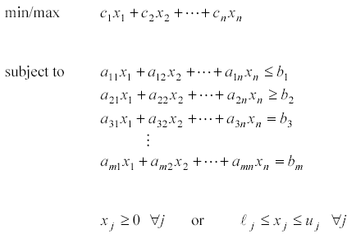
General Form of a Linear Program
Decision Variables: x₁, x₂, …, x_{n} n = number of decision variables
objective function
m = number of constraints
Make sure everything is linear and non-negative
non-negativity
bounding constraints

Slide 20
Standard Format of a Linear Program
This is the format that must be used in order to apply the simplex method.
will discuss later
Constraints: should be equations (i.e., = constraints)
(e.g., 3x₁ + 4x₂ = 5)
Variables: all non-negative (i.e., variables ≥ 0)
Canonical Format
This format is used to develop duality relationships (covered later).
Min Problem
Constraints ≥
Variables non-negative
Max Problem
Constraints ≤
Variables non-negative

Slide 21
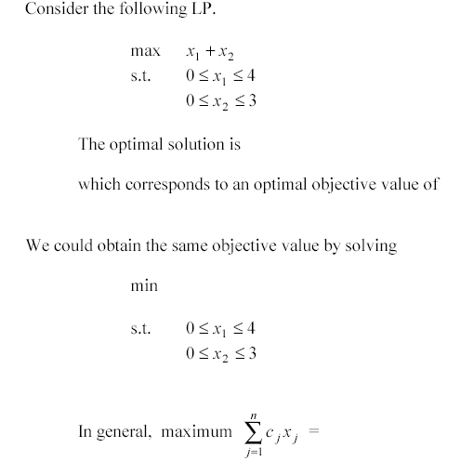
Relationship Between Minimization and Maximization Problems
x₁ = 4, x₂ = 3
7
-
-(x₁ + x₂)
Solution: x₁ = 4, x₂ = 3 Objective Value = -(-7) = 7
- Minimum

Slide 22
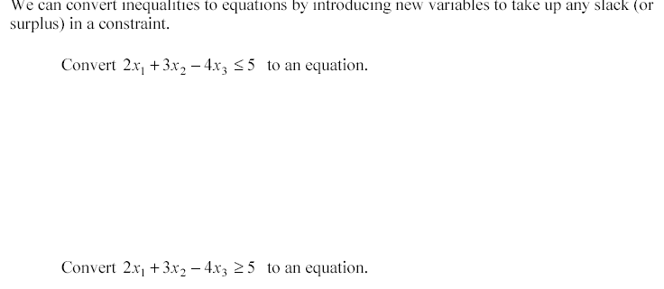
Converting Inequalities to Equations
2x₁ + 3x₂ – 4x₃ + s₁ = 5; s₁ is non-negative variable called a slack variable For Example: x₁ = 1, x₂ = 1, x₃ = 2, s₁ = 8
2x₁ + 3x₂ – 4x₃ – s₂ = 5; s₂ is non-negative variable called a surplus variable
If = constraint, convert into two constraints (both ≥and ≤).
2x₁ + 3x₂ – 4x₃ = 5; convert to: 2x₁ + 3x₂ – 4x₃ + s₁ = 5 and 2x₁ + 3x₂ – 4x₃ - s₂ = 5

Slide 23
Non-negativity of the Variables
For many problems, the variables are naturally nonnegative. If this is not the case for some variable, then we must replace it by some other nonnegative variable(s).
Unrestricted Variables: Suppose that x_{j} is unrestricted in sign.
Option 1: Replace x_{j} by the difference of two non-negative variables.
Option 2: Choose any equation in which x_{j} appears, solve for x_{j} in terms of other variables. Then substitute for x_{j}.
Example: x₁ + x₂ – x₃ = 5, with x₂ unrestricted

Slide 24
Non-negativity of the Variables …
Lower-bounded Variables: Suppose that x_{j}≥l_{j}, where l_{j} > 0.
Substitute:
Replace:
Upper-bounded Variables: Suppose that x_{j}≤u_{j}, where u_{j} < 0. (i.e., x_{j} is restricted to be negative)
Substitute:
Replace:

Slide 25
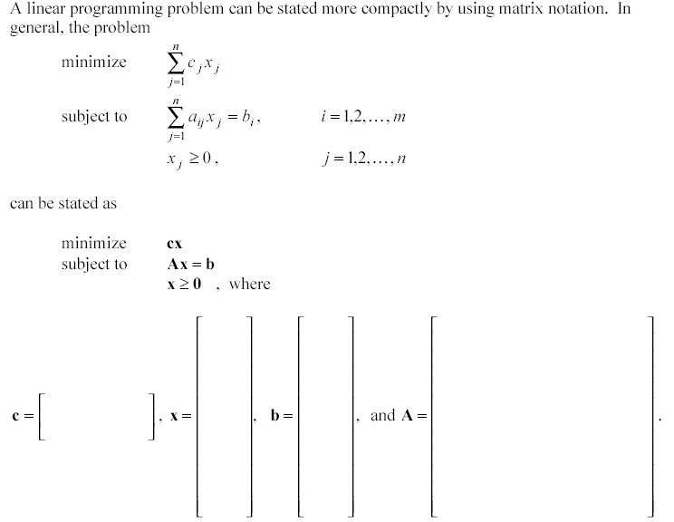
Matrix Notation for LPs
i – represent rows j – represent columns A is m x n m rows and n columns
a₁₁ , a₁₂, … , a_{1n}
x₁, x₂, . . . x_{n}
b₁, b₂, . . . b_{m}
a₂₁ , a₂₂, … , a_{2n}
… … …
c₁,c₂,…,c_{n}
… … …
… … …
a_{m1} , a_{m2}, … , a_{mn}

Slide 26
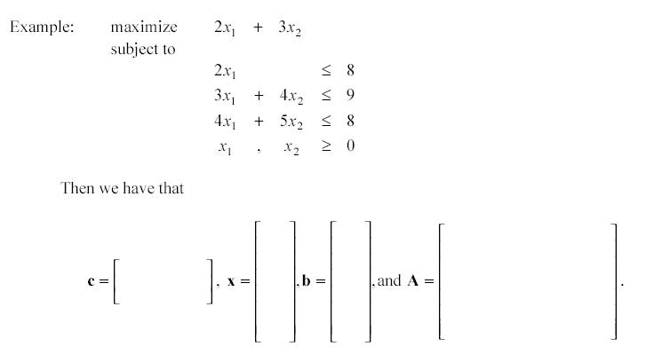
Matrix Notation for LPs …
A is 3 x 2 3 rows and 2 columns
x₁ x₂
8 9 8
2 0 3 4 4 5
2 3

Slide 27
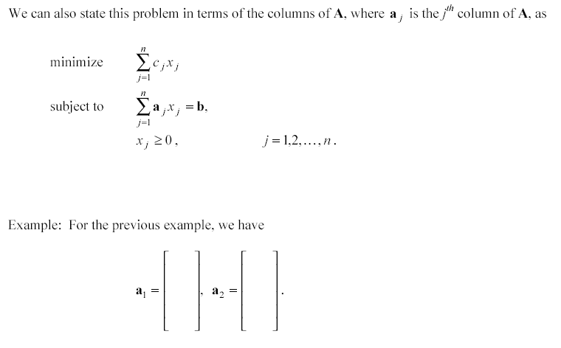
Matrix Notation for LPs …
2 3 4
0 4 5
Another way to describe a_{j} is a_{.j}

Slide 28
Matrix Notation for LPs …
Therefore, we can state the optimization problem as:

Slide 29
Example: Basic Solutions
Nonbasic Variables
Basic Variables
Basis Matrix
Point (on graph)
This is a Basic Infeasible Solution, since x₄ is negative. Note, we are not in the feasible space (on graph).
This is a Basic Feasible Solution (BFS), since the basic variables are all non-negative (we are at a feasible point).

Slide 30
Example: Basic Solutions
Nonbasic Variables
No Solution! (Obviously, since these two constraints will never intercept since they are parallel.)
In General …
What is the upper bound on the number of basic solutions?
The combination of choosing m from n.
For our example:
Why is this important? We know that the number of basic solutions is an upper bound on the number of basic feasible solutions. We also know that, if an optimal solution exists, then it at least one answer will occur at a basic feasible solution. Therefore, there are only a finite number of points we need to evaluate.

Slide 31
Back to the Example …
Where are the 10 basic solutions? 5 are basic feasible solutions (corresponding to the 5 extreme points) 4 are infeasible 1 does not exist
Note: Adjacent Extreme Points differ by exactly one basic and non-basic variable. So if you switch one basic with one non-basic variable, then you will move to an adjacent extreme point.
Strategy (Algebra of the Simplex Method):
Move from one extreme point to an adjacent extreme point by interchanging one basic and one non-basic variable. Pick an easy basic feasible solution (i.e., easy to solve). Form the canonical form. Solve for Z and basic variables in terms of nonbasic variables. Then determine if optimal. If optimal, then you are done. If not optimal, determine which nonbasic variable to make basic and how big to make it (by looking at constraints).

Slide 32
Back to the Example: Using Our Strategy
Easy Start:
Canonical Form:
BFS Summary:
Z=0
Is current BFS optimal? NO! Look at Z equation.
Increasing x₁ by one unit will increase Z by 5 units. Therefore, we want to increase x₁. So we make x₁ basic. (Also known as the “entering” variable).
Note: we picked x₁ since it increases Z by the most per unit, this is not always the most efficient choice, but it is the logical choice.

Slide 33
Back to the Example: Using Our Strategy …
How much do we increase x₁ by? Look at constraints.
Need to keep all variables non-negative to remain feasible.
If x₁ is increased, what happens to the non-basic variables x₃, x₄, and x₅? (how much can we increase x₁ before one of those variables becomes non-negative?)
x₁ must satisfy all three conditions, so x₁≤ 6 x₅ is the “leaving” variable. x₅ is going to become non-basic.
So we are interchanging x₁ with x₅. This is called a Pivot. We have to substitute x₁ for x₅ (i.e., x₅ = 6-x₁).

Slide 34
Back to the Example: Using Our Strategy …
BFS Summary:
Z=30
Is current BFS optimal? No x₂ enters, becoming basic
x₂ must satisfy all three conditions, so x₂≤ 3 x₃ is the “leaving” variable. x₃ is going to become non-basic.
Pivot: substitute x₂ for x₃ (i.e., x₃ = 6-2x₂+3x₅).
Corrected!

Slide 35
Back to the Example: Using Our Strategy …
BFS Summary:
Z=36
Is current BFS optimal? Yes!

